Slide 1
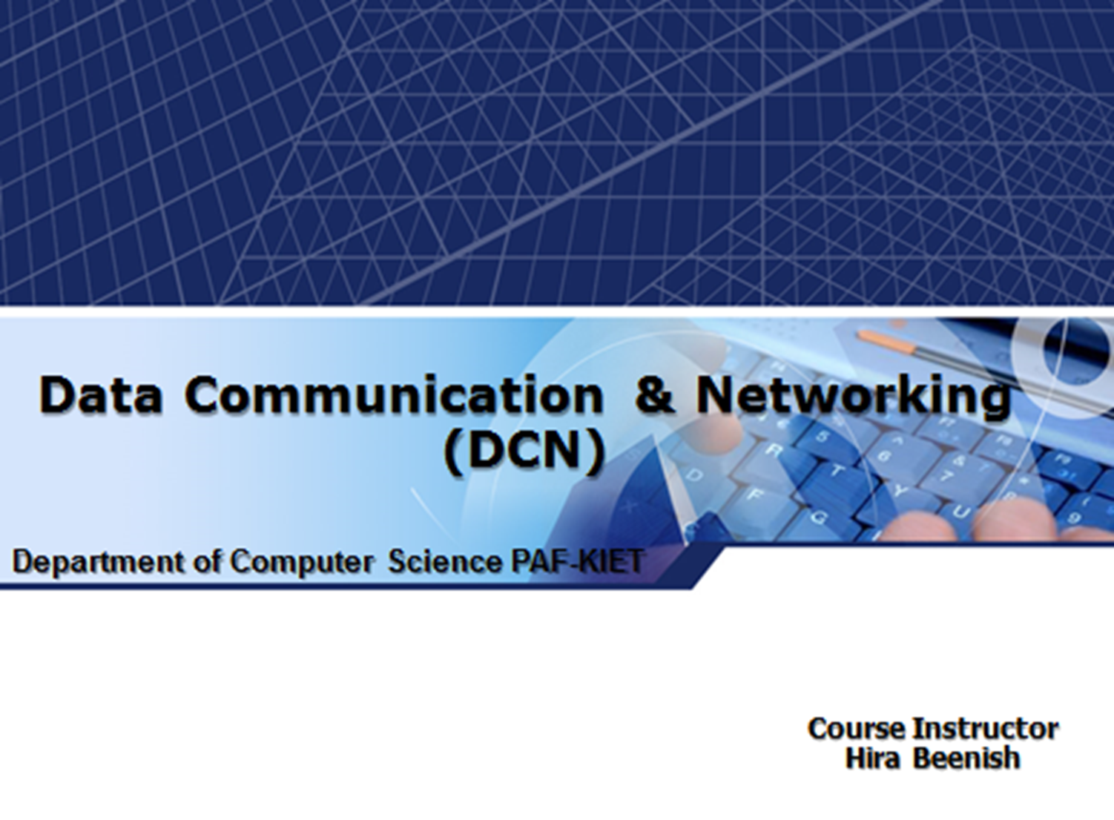

Slide 2
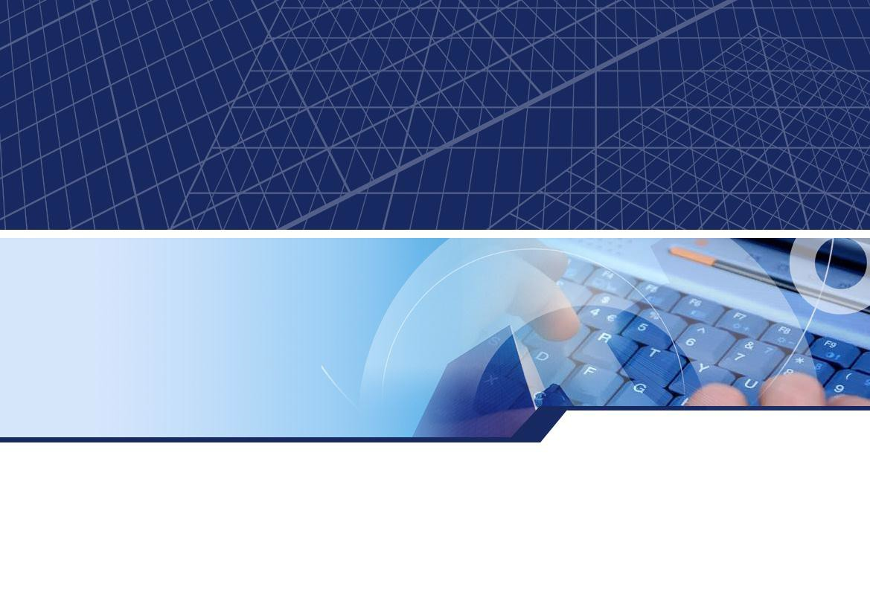
CHAPTER 9 Connecting LANs,
Backbone Networks, and Virtual LANs
4-1

Slide 3
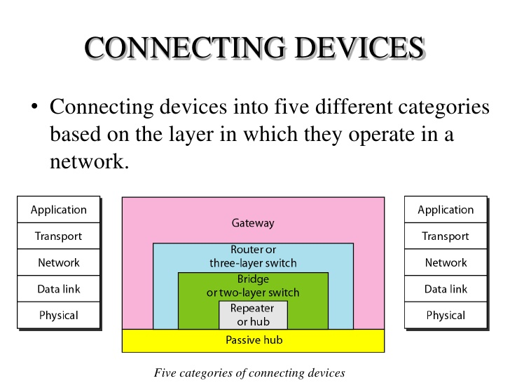



CONNECTING D
Application
Transport
Network
Data link
Physical
Gateway
Router or three-layer switch
Bridge
or two-layer switch
I '
Repeater or hub
Passive hub
I

Slide 4
CONNECTING DEVICES
Repeaters
Hubs
Bridges
Two-Layer Switches
three-layer switch
Routers

Slide 5
Repeaters
A repeater is a device that operates only in the phys ical layer.
A repeater receives a signal and, before it becomes too weak or corrupted, regenerates the original bit p attern.
A repeater connects segments of a LAN.
A repeater forwards every frame; it has no filtering c apability.
A repeater is a regenerator, not an amplifier.

Slide 6
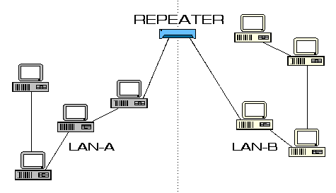

Slide 7
Hubs
An active hub is actually a multipart repeater
In a hub, when one PC sends data onto the wire, the hub simply forwards the packets to a ll the other devices connected to it.
Each device is responsible for determining w hich packets are destined for it and ignoring t he others.

Slide 8
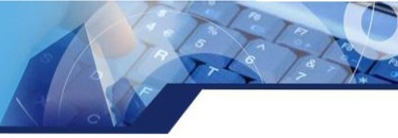
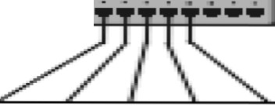




Hubs
HUB
· '· =-
STRAIGHT -TH RU CABLES

Slide 9
Bridges
A bridge operates in both the physical and the data link lay er
As a data link layer device, the bridge can check the physic al (MAC) addresses (source and destination) contained in t he frame.
A bridge has a table used in filtering decisions
A bridge has filtering capability.
bridges had forwarding tables that were static
The systems administrator would manually enter each tabl
e entry during bridge setup.

Slide 10
Learning Bridges
A better solution to the static table is a dynamic tabl e that maps addresses to ports automatically. To m ake a table dynamic, we need a bridge that graduall y learns from the frame movements.
A learning bridge can be added to a network, and it will learn the network topology without help from hu mans

Slide 11
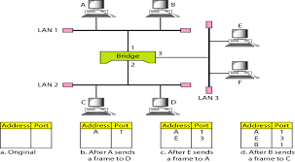
Learning Bridge

Slide 12
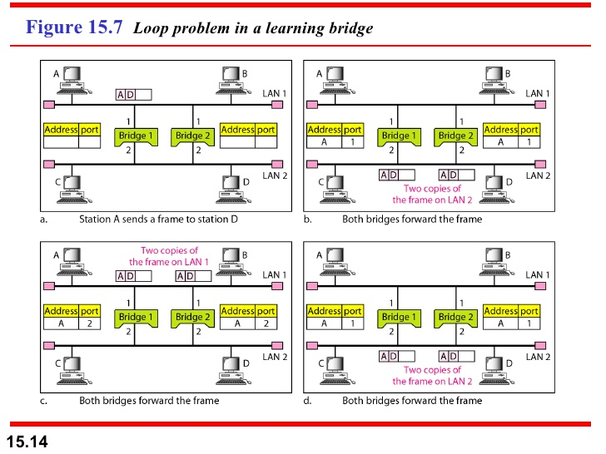
Loop Problem in Learning Bridge

Slide 13
Two-Layer Switches
The two-layer switch performs at the physical and d ata link layers.
A two-layer switch is a bridge, a bridge with many p orts and a design that allows better (faster) perform ance.
A two-layer switch makes a filtering decision based
on the MAC address of the frame it received
They check the MAC addresses in the header of the
frame.

Slide 14
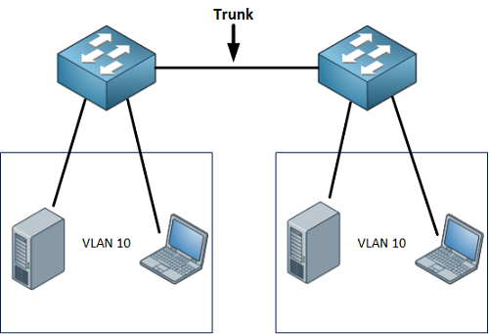
Two Layer Switch

Slide 15
Routers
A router is a three-layer device that routes packets based on their logical addresses
A router normally connects LANs and WANs in the Internet and has a routing table that is used for ma king decisions about the route
The routing tables are normally dynamic and are u
pdated using routing protocols.
Internet that uses routers to connect LANs and WA
Ns.

Slide 16
Gateway
A gateway is normally a computer that operates in all five layers of the Internet or seven layers of OS I model
The gateway connecting the two systems can tak e a frame as it arrives from the first system, move it up to the OSI application layer, and remove the message.

Slide 17
BACKBONE NETWORKS
A backbone network allows several LANs to be con nected.
A portion of a computer network that is capable of c arrying the majority of traffic on the network at high speeds
Bus Backbone
Star Backbone

Slide 18
VIRTUAL LANs
We can roughly define a virtual local area networ k (VLAN) as a local area network configured by s oftware, not by physical wiring.
Welcome to the wonderful world
of VLANs

Slide 19
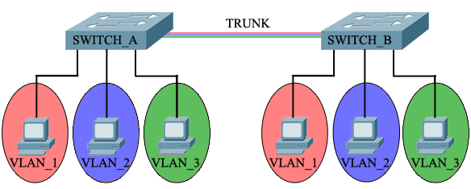
Vlan

Slide 20
VLANS = SEPARATE BROADCAST DOMAINS
With the creation of our VLANs, we have also c reated 2 broadcast domains. This mean that if a ny workstation in either VLAN sends a broadca st, it will propagate out the ports which belong t o the same VLAN as the workstation that gener ated the broadcast

Slide 21
Advantages
Cost and Time Reduction
VLANs can reduce the migration cost of stations going
from one group to another
Creating Virtual Work Groups
VLANs can be used to create virtual work groups
Security
VLANs provide an extra measure of security. People be longing to the same group can
send broadcast messages with the guaranteed assuran
ce that users in other groups will
not receive these messages

